Slide 1
Dark patterns & persuasion CSCI 3002 Fall 2018
Notes:
http://homrj.files.wordpress.com/2009/12/cat8_gallery__394x4000.jpg

Slide 2
Where we are
Four weeks of practice in designing interactive systems: sketching, prototyping
What is known about “good” design: models of usability, visual design
By now you should be capable of turning an idea or specification into an interactive prototype, leveraging some design strategies and avoiding pitfalls

Slide 3
A few notes on designing interfaces
Inclusion in design: assistive technology vs. universal design
Stakeholders and non-targeted use: users may be different than who we expect, may use things differently than we suspect

Slide 4
Inclusion in design
Consider universal design solutions – make your stuff work for everybody
Avoid “disability mode”
Can have broad-reaching benefits

Slide 5
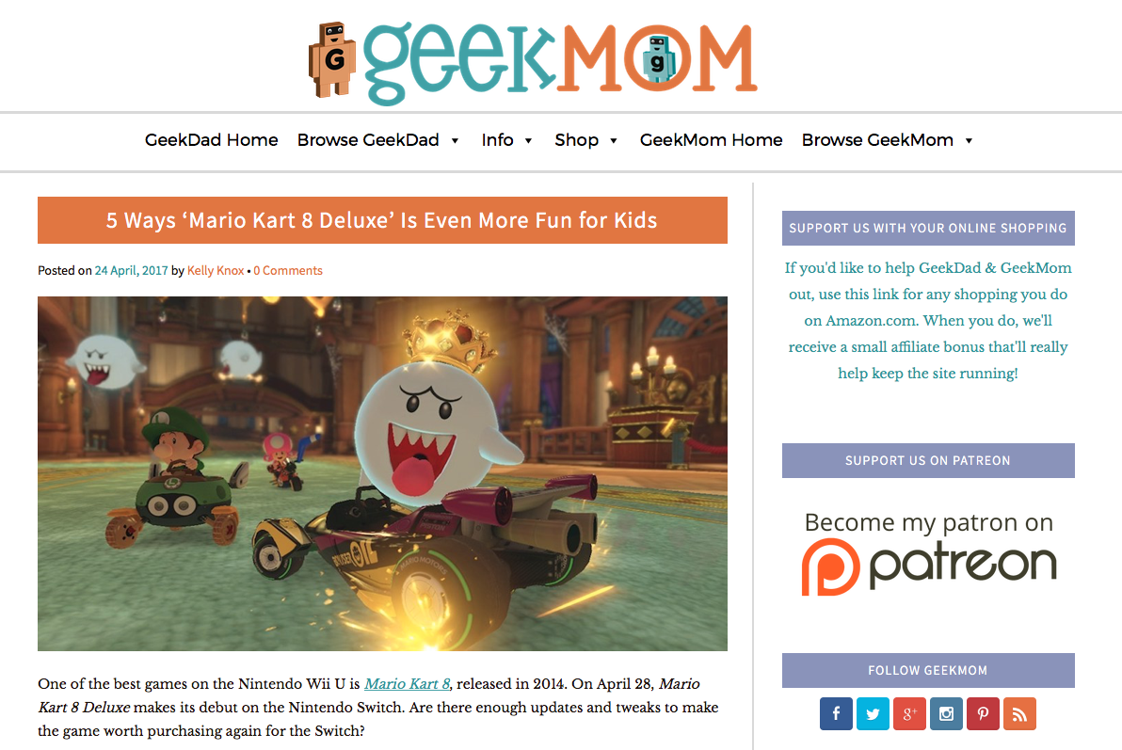
Notes:
https://geekdad.com/2017/04/5-ways-mario-kart-8-deluxe/

Slide 6
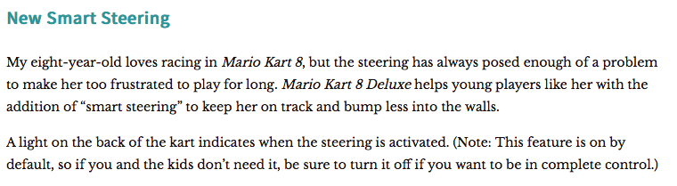
Notes:
https://geekdad.com/2017/04/5-ways-mario-kart-8-deluxe/

Slide 7
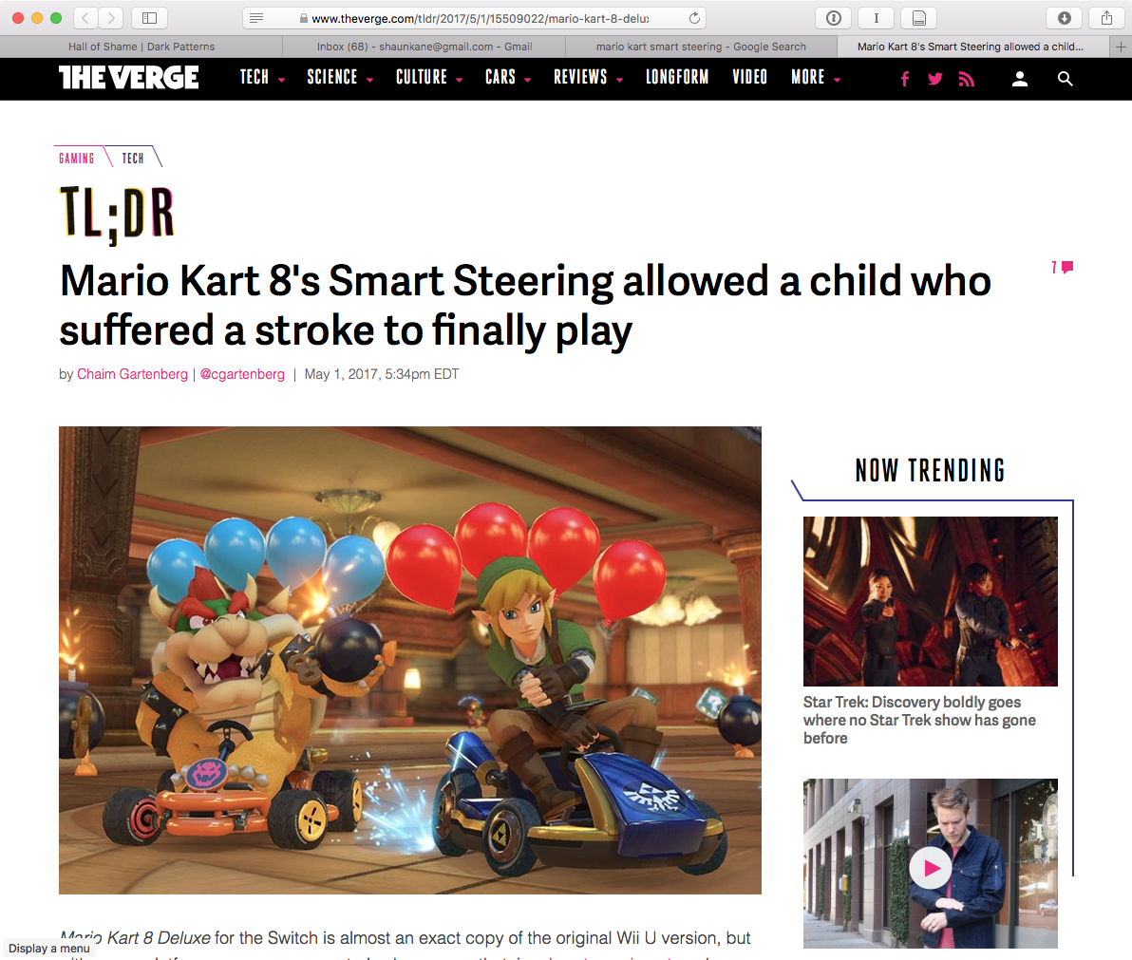
Notes:
https://www.theverge.com/tldr/2017/5/1/15509022/mario-kart-8-deluxe-smart-steering-auto-drive-accessibility-controls

Slide 8
Users vs. stakeholders (or primary vs. secondary users)
Remember that the primary user is often not the only person who interacts with a computing system
Consider a new electronic door lock system for CU dorms
Who is the primary user?
Who else might interact with the system?
Who might have a broader stake in the system?

Slide 9
Non-targeted use
Some users will find unexpected uses for your technology
Some may even use your technology for nefarious purposes!
It’s helpful to consider non-targeted use, and observe over time
Notes:
Here is an example where the feature was integrated! kinda cool

Slide 10
Making things difficult
Are there times when we want to make a task more difficult to perform?
Notes:
Car image: http://blog.toyotaofnorthcharlotte.com/wp-content/uploads/2015/11/parking-brake.png
Pills: https://qz.com/796794/clearrx-people-are-digging-through-their-trash-to-save-targets-well-designed-prescription-pill-bottles/
Note these are different!

Slide 11
Making things difficult
There are various reasons why we might make something difficult to do
Notes:
Car image: http://blog.toyotaofnorthcharlotte.com/wp-content/uploads/2015/11/parking-brake.png
Pills: https://qz.com/796794/clearrx-people-are-digging-through-their-trash-to-save-targets-well-designed-prescription-pill-bottles/
Note these are different! One is about making an action difficult to perform accidentally; the other is to protect against certain users
For things like deleting files, we might want to allow it, but allow undi

Slide 12
Today
How to be evil
Notes:
As we all know, the Injustice League is the inverted bad guys

Slide 13
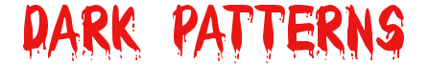
No seriously
How can we use what we know about good design practices to misdirect or influence users?
We call these
(following from Christopher Alexander’s design patterns)
Notes:
https://www.font-generator.com/fonts/Bloody/

Slide 14
Why study dark patterns?
Protect ourselves against misdirection
Learn from highly motivated designers (whose motives are often knowable)
Flex our design muscles
Notes:
People who do this stuff have clear reasons, so they want to do it well!
Photo: Alan Rickman as Snape in Harry Potter…

Slide 15
What are the goals of dark pattern practitioners?
Keep you locked in
Make you think something else is happening
Redirecting you to some other task
Being misleading about what is required
Countermeasures
Changing difficulty
Bundling unrelated items
Hiding the choices
Notes:
Usually to make money! But how?

Slide 16
Goals
Rather than supporting a user in achieving their own goals, guide the user to a specific goal
While maintaining the illusion of choice
Draw the user’s attention
Miscommunicate the outcome
Notes:
Top: https://twitter.com/chillfinn/status/872389496737861633/photo/1
Bottom: https://twitter.com/kristinalustig/status/874986152012505088/photo/1

Slide 17
Draw user attention
Notes:
Bottom: https://twitter.com/kristinalustig/status/874986152012505088/photo/1

Slide 18
Miscommunicate the outcome
Notes:
Bottom: https://twitter.com/kristinalustig/status/874986152012505088/photo/1

Slide 19
Dark patterns in the physical world
Notes:
Left: Williams and Graham bar door, from https://lifeandthyme.com/wp-content/uploads/2016/01/williams-and-graham-16-669x1024.jpg
It’s hiding the affordance! In this case, this is intended for fun.

Slide 20
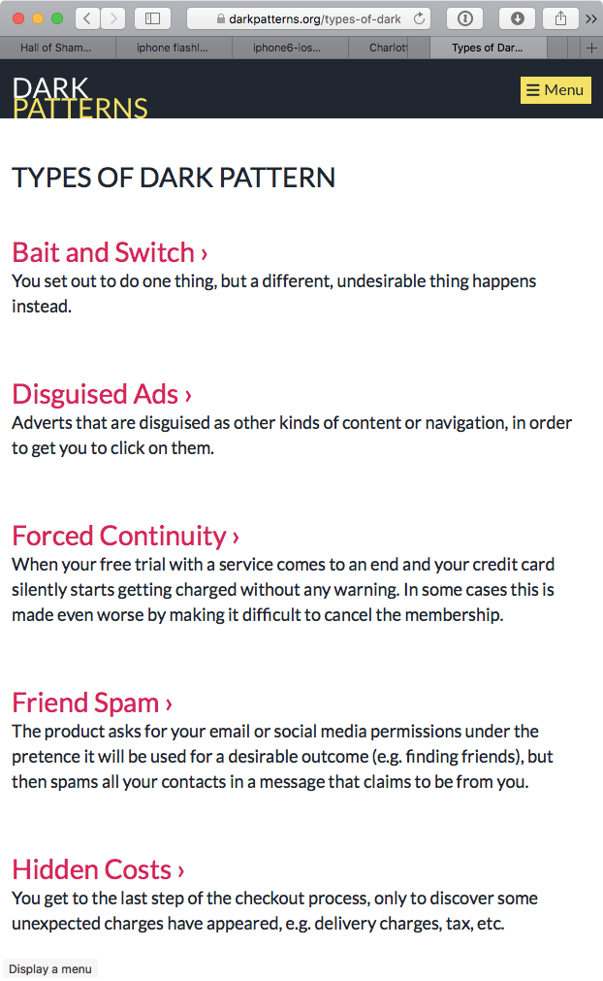
Understanding dark patterns
Growing collection of examples at darkpatterns.org
Many techniques for misdirecting users
We’ll focus on what we know
Notes:
https://darkpatterns.org/types-of-dark-pattern

Slide 21
Getting started
We can learn the basics of dark patterns by inverting our good patterns
Make important actions clear → make desired actions clear (and hide others)
Make system status visible → hide or mislead about system status
Recognition rather than recall → require users to perform complex steps to perform undesired actions
Notes:
https://darkpatterns.org/types-of-dark-pattern

Slide 22
Activity
Let’s design interfaces to manipulate users
We’ll manipulate a course search page to:
Encourage or discourage students to sign up for more courses
Encourage students to sign up for CSCI courses
Encourage students not to over-enroll

